Slide 1
Water
By Nayer Masoud

Slide 2
Why care about water.
Water is the most valuable recourses in our planet, it helps our food grow and keeps us alive
Our bodies are made up of 70% of water meaning we need to replenish it daily.
We can live without food for weeks but only live without water for three days.
Water also holds the most organisms on the planet from the smallest fish to the biggest of whales.

Slide 3
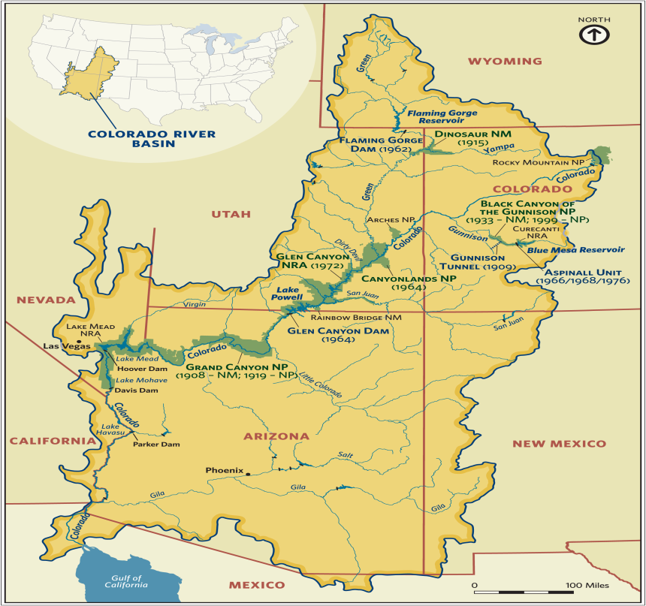
The Colorado river
The Colorado river is on the largest rivers
in the world.
The Colorado river has been sculpting the gran canyon for over 6 million years.
but now the Colorado river is drying out and some of it’s rivers like the Gila has stopped flowing into the ocean. And are drying out.

Slide 4
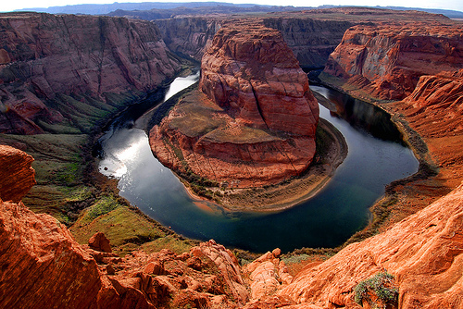
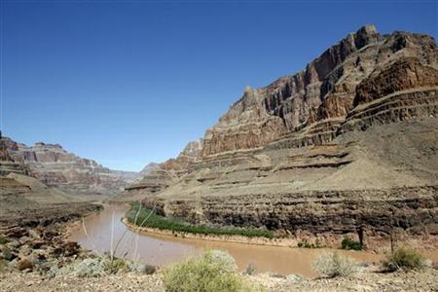
The Colorado river
Then
Now

Slide 5
The solution
new innovative irrigation techniques, which many farmers around the world are starting to use, can help ensure continued agricultural production, while cutting water demands, even in the fact of the growing threat of climate change.

